Slide 1
Implementing Public Key/Asy Infrastructure
Lesson 6
M6S1 Introduction to Cybersecurity Defense
Notes:
This lesson focuses on the practical side of implementing cryptographic infrastructure. You will be returning to the actual systems that use cryptography (authentication, SSL/TLS, VPN, WPA, and so on) throughout the rest of the course.
Topics:
Implement certificates and certificate authorities.
Implement PKI management.

Slide 2
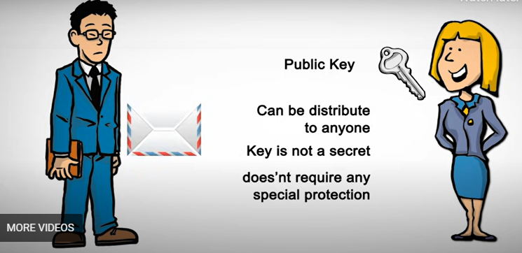
The scenario and problem
M6S1 Introduction to Cybersecurity Defense

Slide 3
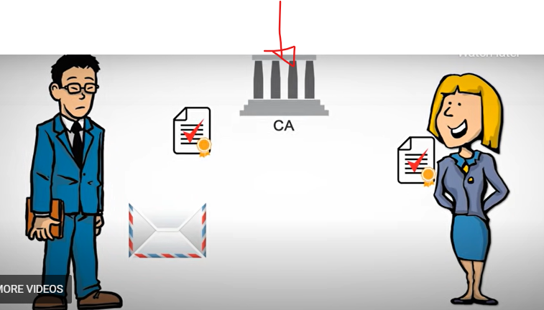
Solution by KPI
M6S1 Introduction to Cybersecurity Defense

Slide 4
Implement Certificates and Certificate Authorities
Topic 6A
M6S1 Introduction to Cybersecurity Defense
Notes:
As the previous lesson covered a lot of theory, you may prefer to focus more on labs for this topic. Most of the content examples are straightforward.

Slide 5
Public and Private Key Usage
Public key cryptography
When you want others to send you confidential messages, you give them your public key to use to encrypt the message
When you want to authenticate yourself to others, you create a signature and sign it by encrypting the signature with your private key
But how does someone trust the public key?
Public key infrastructure (PKI) validates the identity of the owner of a public key
Public key is wrapped in a digital certificate signed by a certificate authority (CA)
Sender and recipient must both trust the CA
M6S1 Introduction to Cybersecurity Defense
Notes:
This is a quick recap of the last topic in the previous lesson. Emphasize the use of public and private keys before attempting to move on.

Slide 6
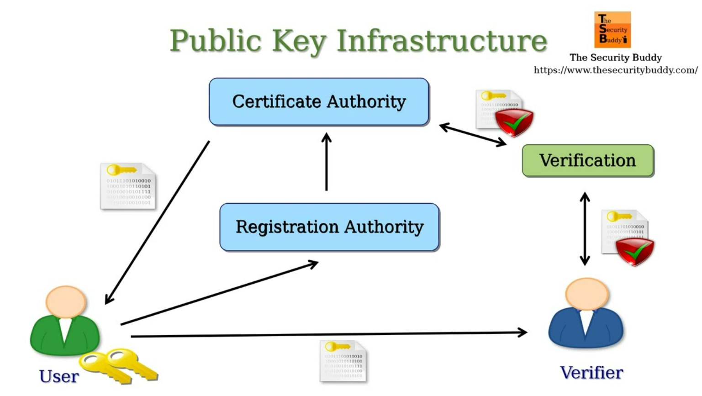
Syllabus Objectives Covered
3.9 Given a scenario, implement public key infrastructure
M6S1 Introduction to Cybersecurity Defense

Slide 7
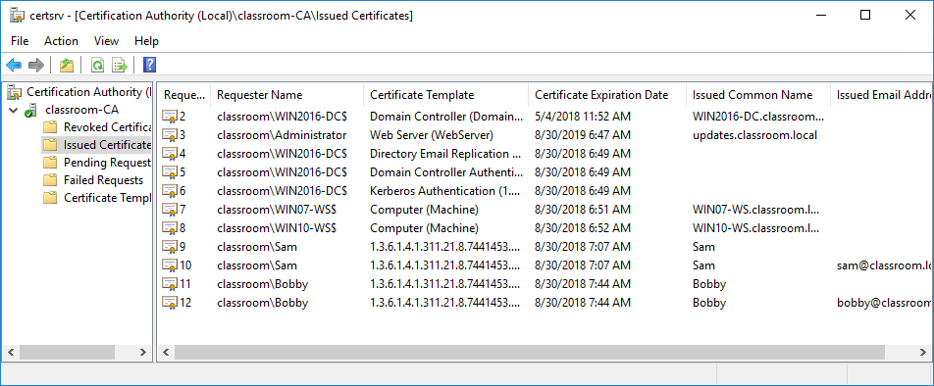
Certificate Authorities (CA) is a trusted organization that issues digital certificates for websites and other entities
Private CAs versus third-party CAs
Define services offered
Ensure validity of certificates and users
Establish trustworthy working procedures
Manage servers and keys
Screenshot used with permission from Microsoft.
M6S1 Introduction to Cybersecurity Defense

Slide 8
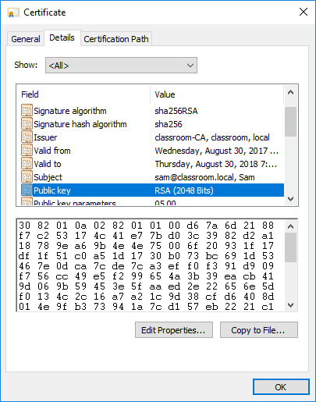
Digital Certificates
Contains subject’s public key
Information identifying the subject plus usage and validity
Digital certificate standards
X.509 Public Key Infrastructure (PKIX)
PKCS (Public Key Cryptography Standards)
Screenshot used with permission from Microsoft.
M6S1 Introduction to Cybersecurity Defense
Notes:
The X.509, PKIX, and PKCS standards aren't listed in the syllabus, so students should not need to learn them. We include them here just for reference

Slide 9
Certificate Attributes
Field | Usage
Serial Number | A number uniquely identifying the certificate within the domain of its CA.
Signature Algorithm | The algorithm used by the CA to sign the certificate.
Issuer | The name of the CA.
Valid From/To | Date and time during which the certificate is valid.
Subject | The name of the certificate holder, expressed as a distinguished name (DN). Within this, the Common Name (CN) part should usually match either the fully qualified domain name (FQDN) of the server or a user email address.
Public Key | Public key and algorithm used by the certificate holder.
Extensions | V3 certificates can be defined with extended attributes, such as friendly subject or issuer names, contact email addresses, and intended key usage.
Subject Alternative Name (SAN) | This extension field is the preferred mechanism to identify the DNS name or names by which a host is identified.
M6S1 Introduction to Cybersecurity Defense
Notes:
Object identifiers (OIDs) have been removed as a content example, but remain in the acronym list. The term is included in the glossary, but you might want to mention here that these attributes all have numeric identifiers.
Show the attributes of a web server certificate in a browser. Firefox's certificate page is more readable than the standard Windows dialog.

Slide 10
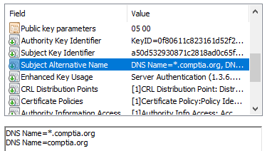
Subject Name Attributes
Common Name (CN) – website name
Legacy method of recording FQDN
Deprecated by standards
BUT still used in many implementations
Subject Alternative Name (SAN)
Structured identifiers
List multiple host/subdomains
Use wildcard subdomain
Screenshot used with permission from Microsoft.
M6S1 Introduction to Cybersecurity Defense
Notes:
The SAN field MUST be configured with the FQDN.
Despite being deprecated for this usage, it is safer to duplicate this information in the CN (knowledge.digicert.com/solution/SO7239) to ensure compatibility.

Slide 11
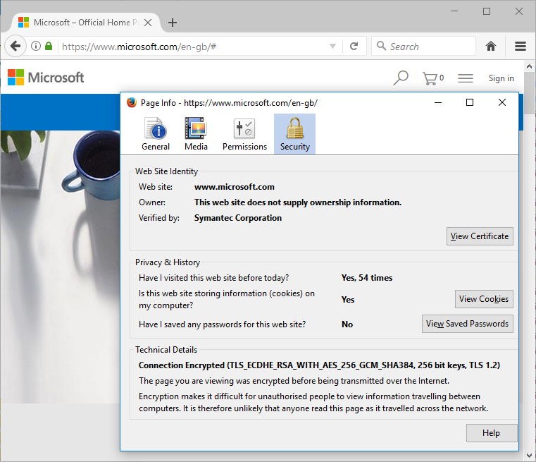
Web Server Certificate Types
Screenshot used with permission from Microsoft.
Domain Validation (DV)
More rigorous identity checks
Extended Validation (EV)
Even more rigorous identity checks
M6S1 Introduction to Cybersecurity Defense
Notes:
Make sure students can distinguish DV and EV and understand the use of SAN or wildcard certificates.

Slide 12
Implement PKI Management
Topic 6B
M6S1 Introduction to Cybersecurity Defense
Notes:
Again, you may prefer to focus more on labs for this topic. Most of the content examples are straightforward, though students can find certificate formats difficult.

Slide 13
Syllabus Objectives Covered
3.9 Given a scenario, implement public key infrastructure
4.1 Given a scenario, use the appropriate tool to assess organizational security (OpenSSL only)
M6S1 Introduction to Cybersecurity Defense

Slide 14
Certificate and Key Management
Key life cycle
Key generation
Certificate generation
Storage
Revocation
Expiration and renewal
Vulnerabilities from improper management
M6S1 Introduction to Cybersecurity Defense
Notes:
We're focusing on public key cryptography here, but do note that symmetric keys and SSH keys have management requirements too. We'll be covering SSH later in the course.

Slide 15
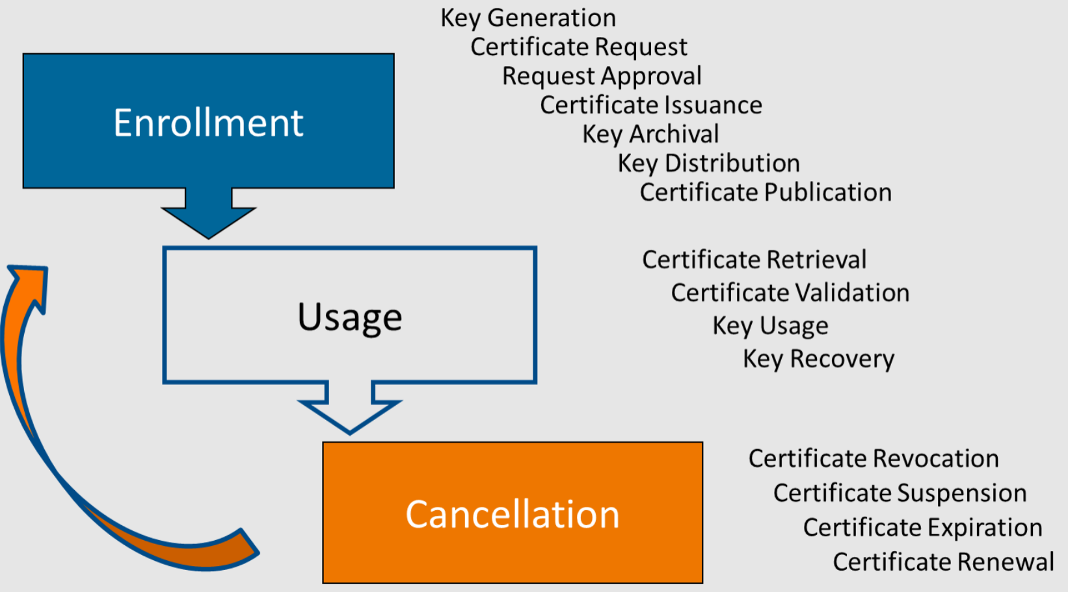
Certificate and Key Management
M6S1 Introduction to Cybersecurity Defense

Slide 16
Key Recovery and Escrow
M-of-N control for critical keys (root servers)
Keys can be backed up to protect against data loss
Anyone with access to backup keys could impersonate the true key holder
Key recovery processes can be protected by M of N control
Escrow backup
Placing archived keys with a trusted third party
M6S1 Introduction to Cybersecurity Defense

Slide 17
Certificate Expiration
Certificate duration
Certificate renewal
Use existing key pair
Re-key with newly generated key pair
Expiration
Public key will no longer be accepted
Archiving versus destroying key material
Secure erasing methods
M6S1 Introduction to Cybersecurity Defense

Slide 18
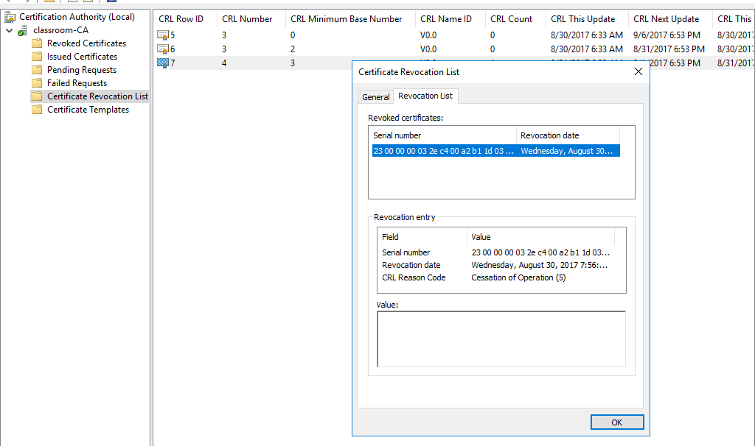
Certificate Revocation Lists
Revocation versus suspension
Reason codes
Certificate Revocation List (CRL)
List of revoked and suspended certificates
Browser CRL checking
Screenshot used with permission from Microsoft.

Slide 19
Certificate Pinning
Certificate pinning restricts which certificates are considered valid for a particular website, limiting risk.
Defend against MitM attacks on chain of trust
Web server references authorized public key(s) in HTTP header
HTTP Public Key Pinning (HPKP)
Certificate Transparency framework
M6S1 Introduction to Cybersecurity Defense

Slide 20
Certificate Issues
Troubleshoot rejection of certificates by servers and clients
Existing certificate—check expiry and status
New certificate
Check key usage settings and requirements
Check subject name
Check chain of trust/root certificates
Verify time and date settings
Audit certificate and PKI infrastructure
M6S1 Introduction to Cybersecurity Defense
Notes:
Troubleshooting is no longer called out on the syllabus, so you may prefer to skip this section. It has been retained as general implementation detail.
Point out that browsers often use a different set of root trusts than Windows itself does.

Slide 21
Summary
Lesson 6
M6S1 Introduction to Cybersecurity Defense
Notes:
Check that students are confident about the content that has been covered. If there is time, revisit any content examples that they have questions about. If you have used all the available time for this lesson block, note the issues and schedule time for a review later in the course.

